Slide 1
Graph Classification Task: Graph Embedding Methods + Spatiality
Yikang Li 2022/8/7

Slide 2

Overview
Binary graph classification Tasks
ADNI dataset - Patients/Controls classes. Node: 90, Amount: 218
AD dataset - AD/CN classes. Node: 90. Amout: 202
Tested the performance of Spatial Graph Neural Networks on different datasets
Tested the different graph embedding methods + spatiality

Slide 3
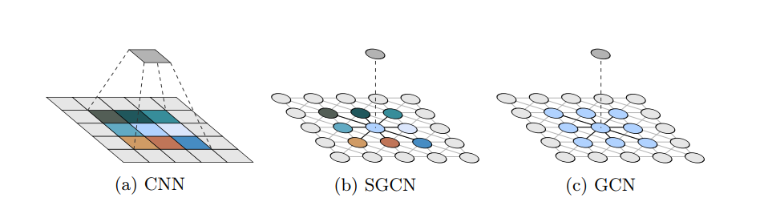
Spatial Graph Convolutional Network:
01 | Comparing to the classical GCN, spatial GCN can effectively extract the geometric/spatial features of graphs by utilizing the node positions.
02 | Spatial GCN is a proper generalization of GCN and CNN, which conbines the advances of GCN and CNN.
03 | It effectively increases the precision on graph classification tasks for super pixel MNIST dataset.
04 | Data Augmentation methods such as node ordering, rotation and translations can be utilized since the spatial GCN can extract the selective invariance of spatial properties.

Slide 4
Results of Spatial GCN on different datasets
1. Spatial GCN does not performs better on two different datasets compared to existed GNN.
2. Adding spatiality to current GNNs does increase the performance of the classification tasks.

Slide 5
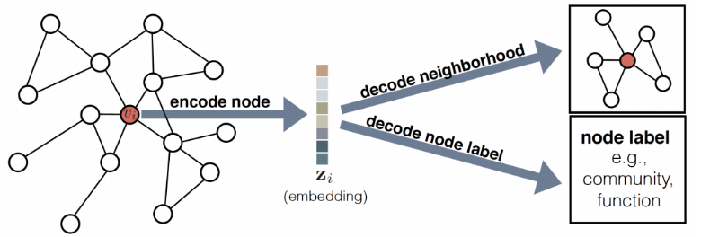
Different Node embedding Methods
1. A node embedding determines a fixed length vector representation for each node. These embeddings are a lower dimensional representation of the graph and preserve the graph’s topology.
2. We can use the embeddings as the features to feed into a machine learning model, rather than generating those features by hand.

Slide 6
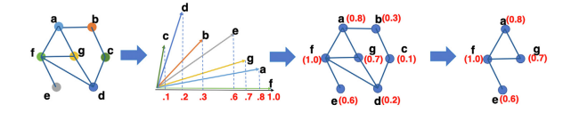
BrainGNN: ROI-based node embedding
1. . Each node is embedded by the particular basis vectors based on the communities that it belongs to.
2. allow Ra-GConv to learn different embedding weights in graph convolutional kernels conditioned on the ROI , instead of using the same weights W

Slide 7
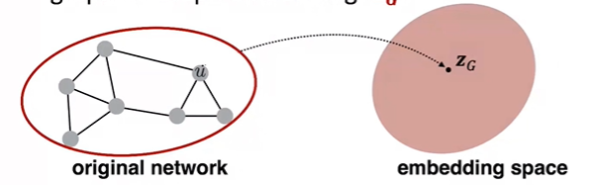
Graph Embedding: Directly embed whole graph
1. Directly embed the whole graph rather than a node.
2. GraphSAGE is a graph embedding method.

Slide 8
Embedding Results:

Slide 9
Thank you.

